Slide 1
Hidden slide
Notes below the pages may be helpful for the teachers.
Notes:
I would like to request my honorable colleagues to follow the instruction below the pages to make the class effective.

Slide 2
Welcome
to my class my dear students.
Good Morning
Notes:
This is a welcome slide.

Slide 3
Lecturer,
Department of English,
Cambrian School
&
College,
Dhaka.
Introduction
English
First Paper
Class- Eight
Mr. Hasan
Notes:
Introduction.

Slide 4
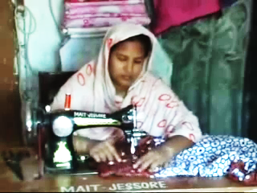
This is Sharmin’s Story but our story is on Rona Begum that means-
Notes:
Teacher may ask the students to say something about the picture & video.

Slide 5
Our Today’s Lesson is-
The story of Rona
Unit-8, Lesson-3
_{News! News! News!}
Notes:
Lesson declaration. Teacher may skip to the page No. 12 directly by clicking right black arrow. If he wants to avoid word meaning section.

Slide 6
Learning outcomes
At the end of this lesson, we will be able -
ask and answer questions
read and understand text materials
write answers to questions
write short paragraphs.
Notes:
This lesson will focus speaking, listening, reading and writing skills.

Slide 7
Hidden page
Key Words
If the students want to know the meaning of the word particularly, teacher may show the word first to ask the meaning, Then he can go ahead accordingly. Teacher should remember that key words are actually for the teacher not for the students exclusively.
Notes:
This is not for the students but for the teachers.

Slide 8
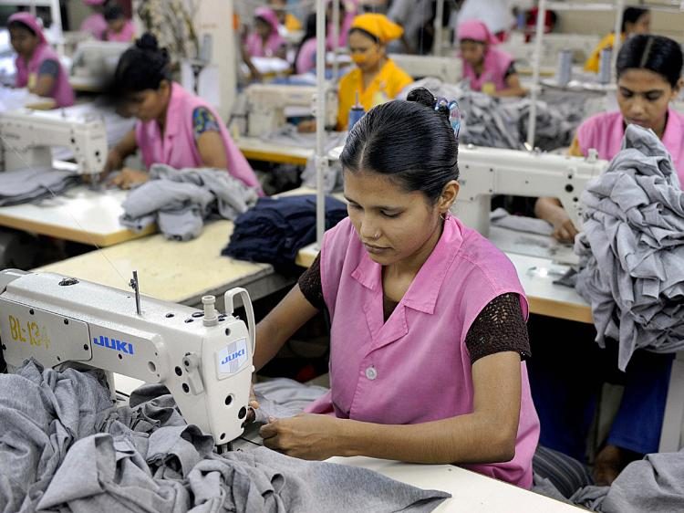
Sewing
Meaning : Stitching, Needlework
She is sewing cloths.
Notes:
Teacher may show the word first to ask the meaning of the word. If they can, that’s ok. Then he can show the meaning and sentence with the word to make them clear.

Slide 9
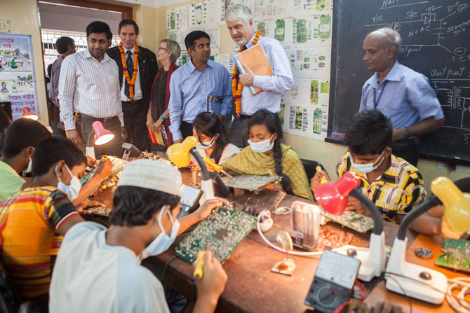
Vocational
Meaning : Occupational, Job-related
I have completed a vocational training.
Notes:
Teacher may show the word first to ask the meaning of the word. If they can, that’s ok. Then he can show the meaning and sentence with the word to make them clear.

Slide 10
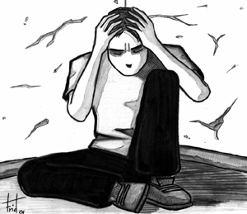
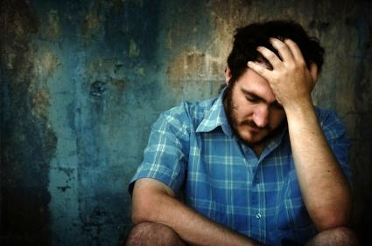
Trouble
Meaning : Worry, suffering
Trouble always creates depression.
Notes:
Teacher may show the word first to ask the meaning of the word. If they can, that’s ok. Then he can show the meaning and sentence with the word to make them clear.

Slide 11
Expand
Meaning : Increasing, grow
He expanded his house.
Notes:
Teacher may show the word first to ask the meaning of the word. If they can, that’s ok. Then he can show the meaning and sentence with the word to make them clear.

Slide 12
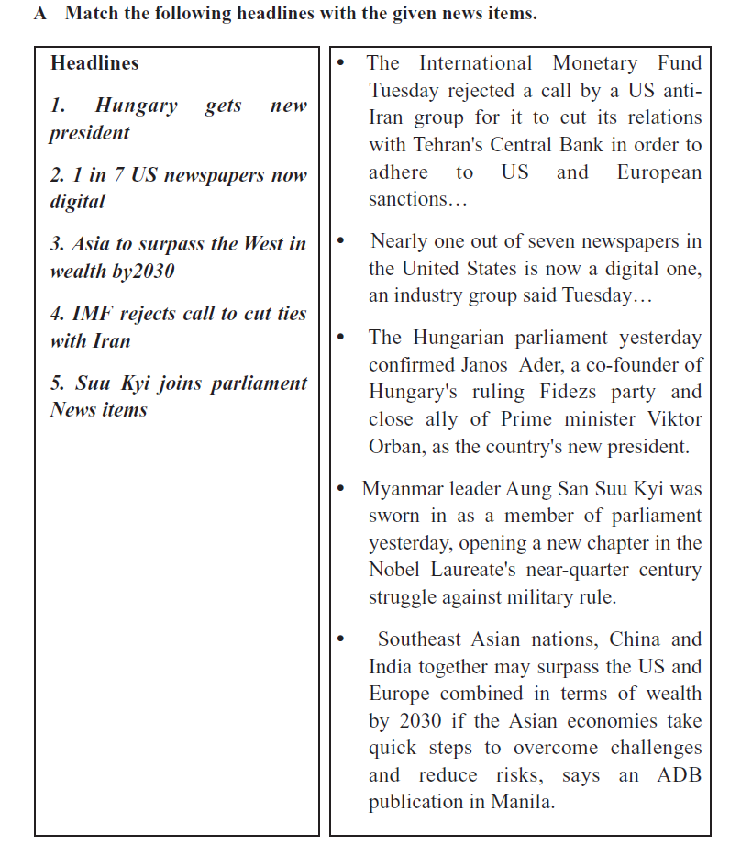
Notes:
Text item.

Slide 13
Let us introduce with a successful woman.
Notes:
Introducing with a successful woman.

Slide 14
Rona Begum
Notes:
Central character of the topic.

Slide 15
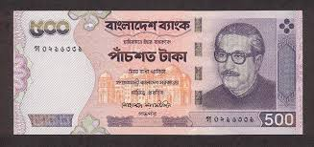
With
5×5 =2,500/-
began her small business. She also had a sewing machine from her sister.
Notes:
Teacher may ask the students to start the lesson with the picture above.

Slide 16
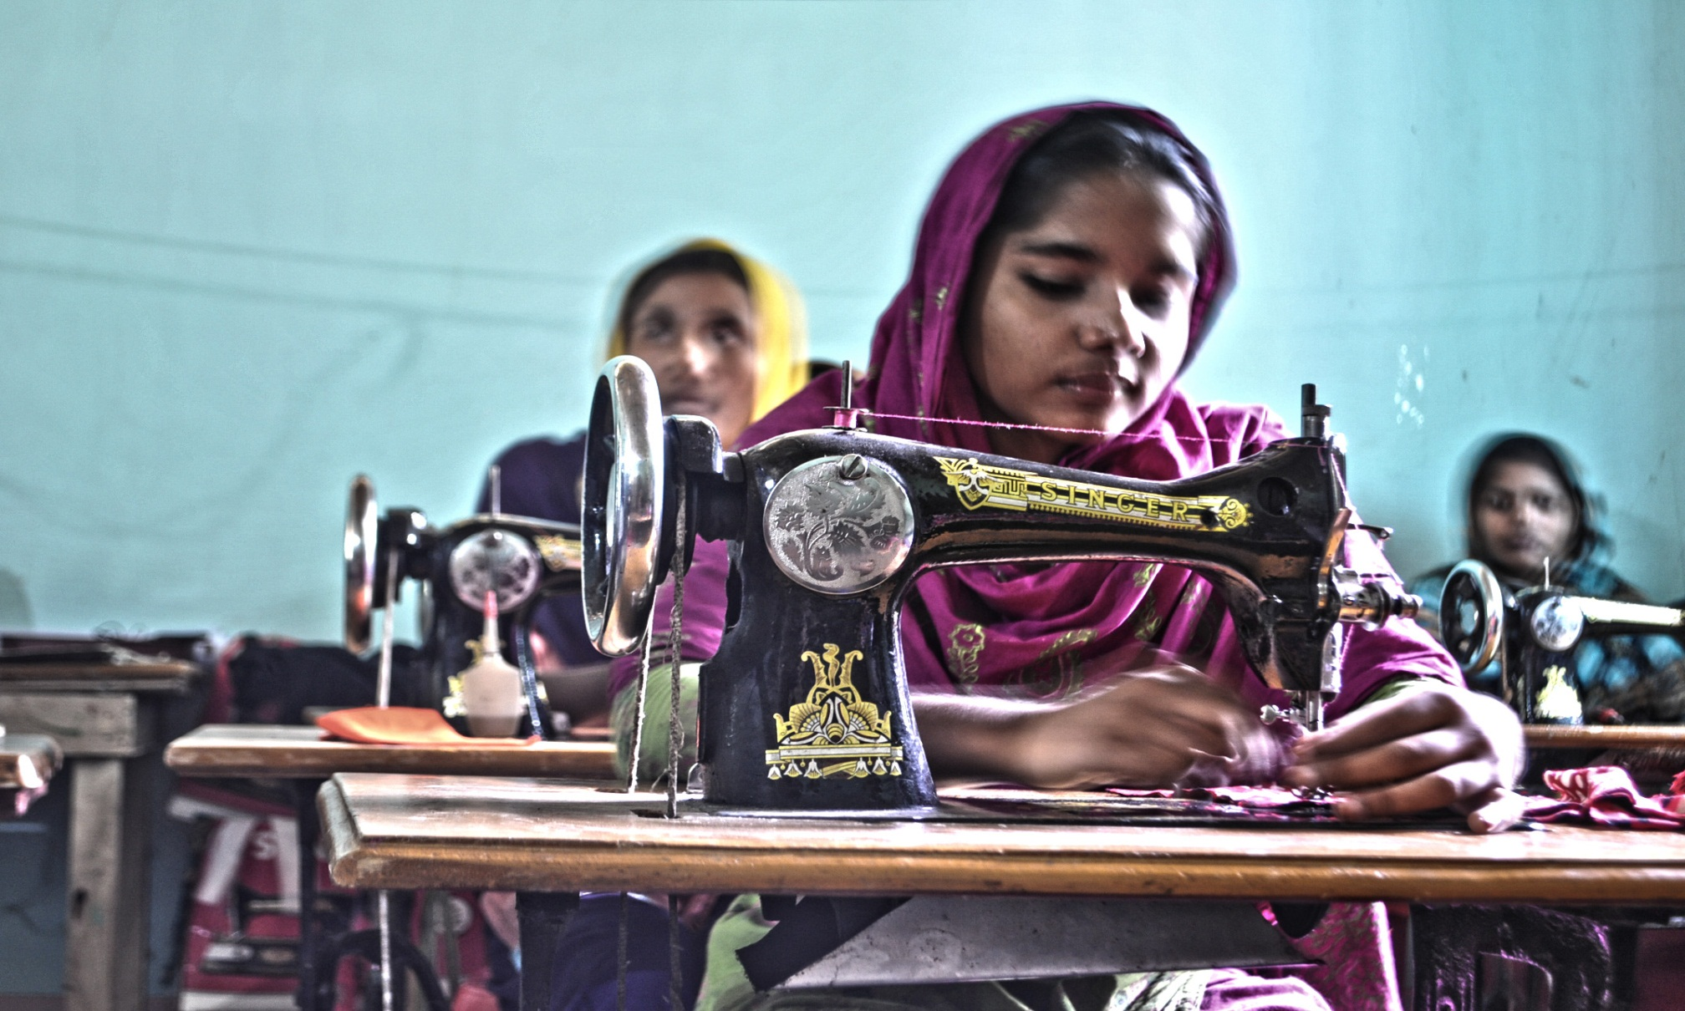
Fifteen years later, she now owns a small production house of fashion garments.
Notes:
Teacher himself may read out the line.

Slide 17
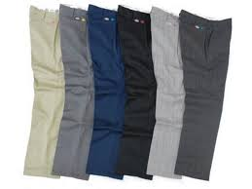
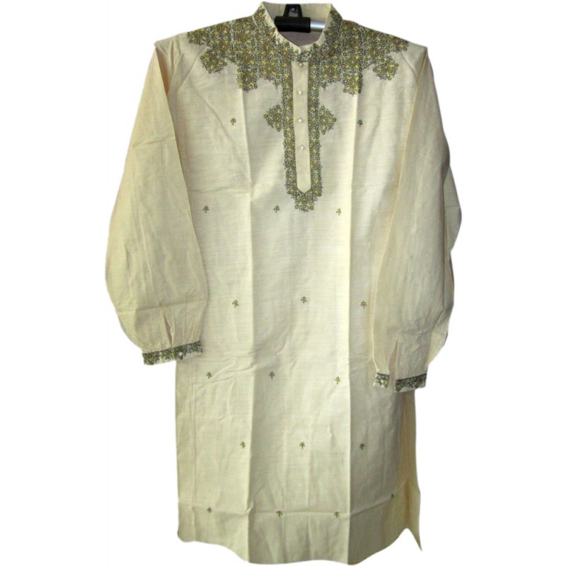
But what does she produce in her fashion garments?
She produces traditional items like-
Shirt
Pant
Panjabi
Notes:
Teacher himself may read out the line.

Slide 18
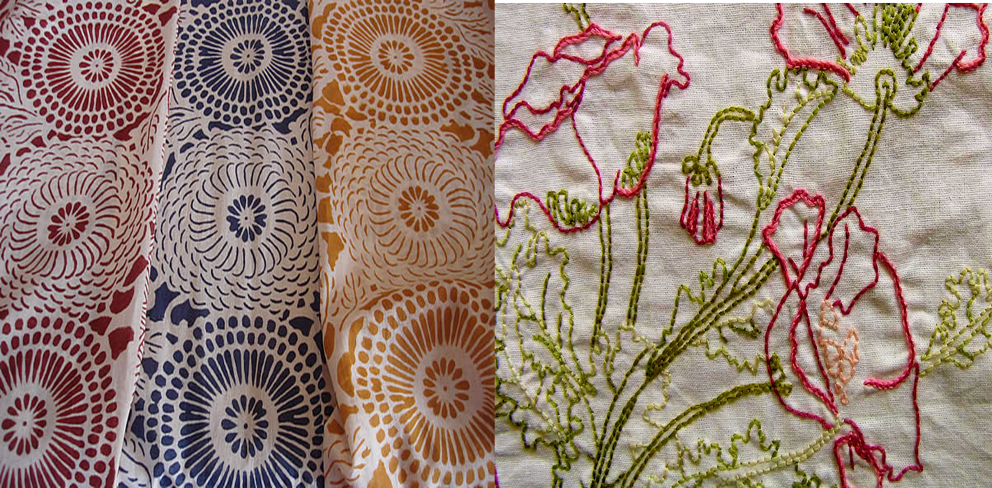
block Print
embroidery
Notes:
Students may tell this option.

Slide 19
"Despite serious trouble in my personal life, I worked very hard to survive.
Notes:
Teacher’s option.

Slide 20
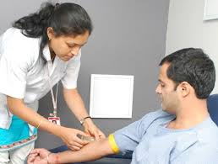
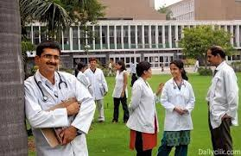
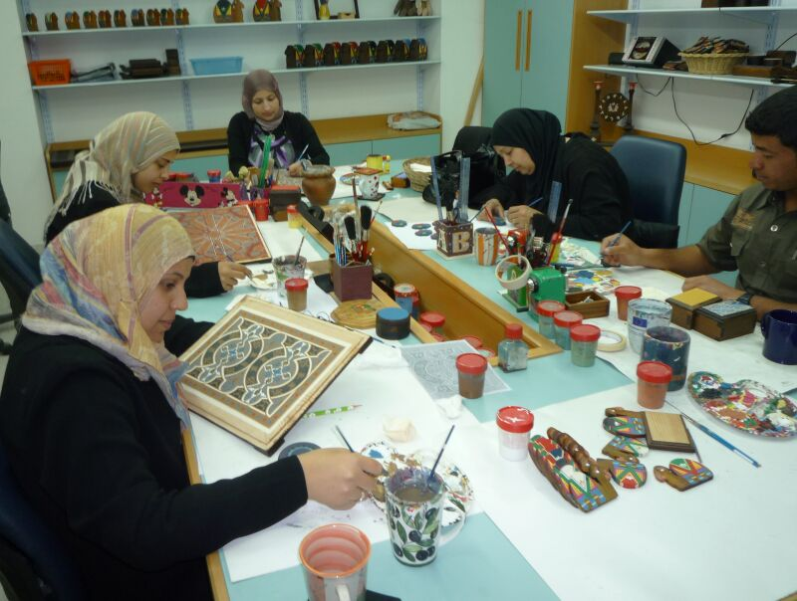
She supported herself by working-
boutique
centre
diagnostic
centre
medical college
Notes:
Teacher lets the students some times to tell about these pictures.

Slide 21
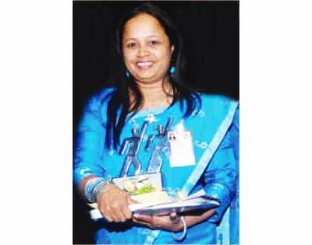
"At first, I got almost no support from my family. Instead, I faced objections. But I'm happy now and busy with my business. The atmosphere at home has also changed,"
Notes:
Teacher’s option.

Slide 22
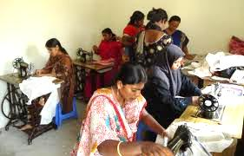
Ms Rona has just started several more commercial projects with partners. She decided to expand business earlier.
Notes:
Teacher’s option.

Slide 23
But she did not get support from any-
bank or financial institution.
Notes:
Teacher may explain it.

Slide 24
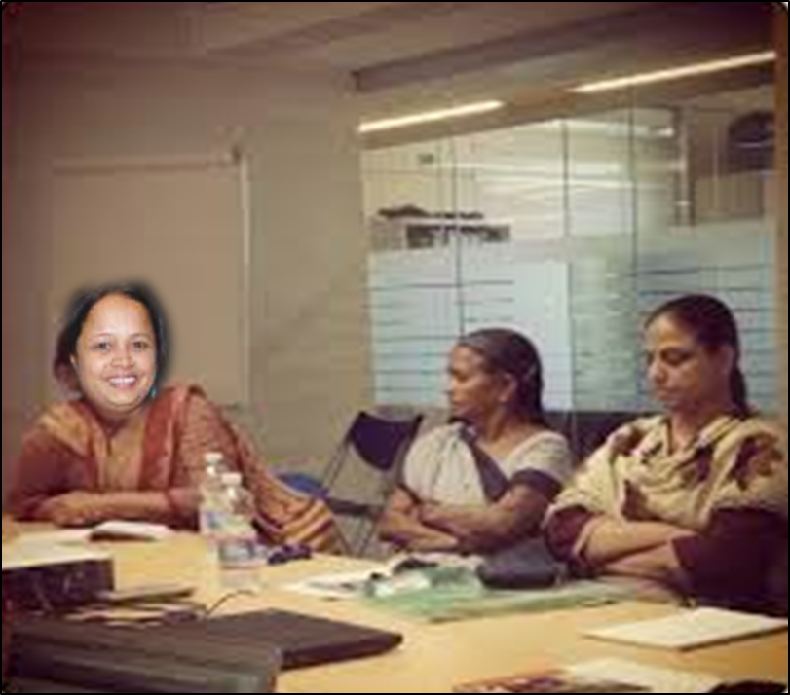
Then she joined the Women Business Forum (WBF), Sylhet and things started to change.
Women
Business
Forum
(WBM)
Notes:
Teacher may explain it.

Slide 25
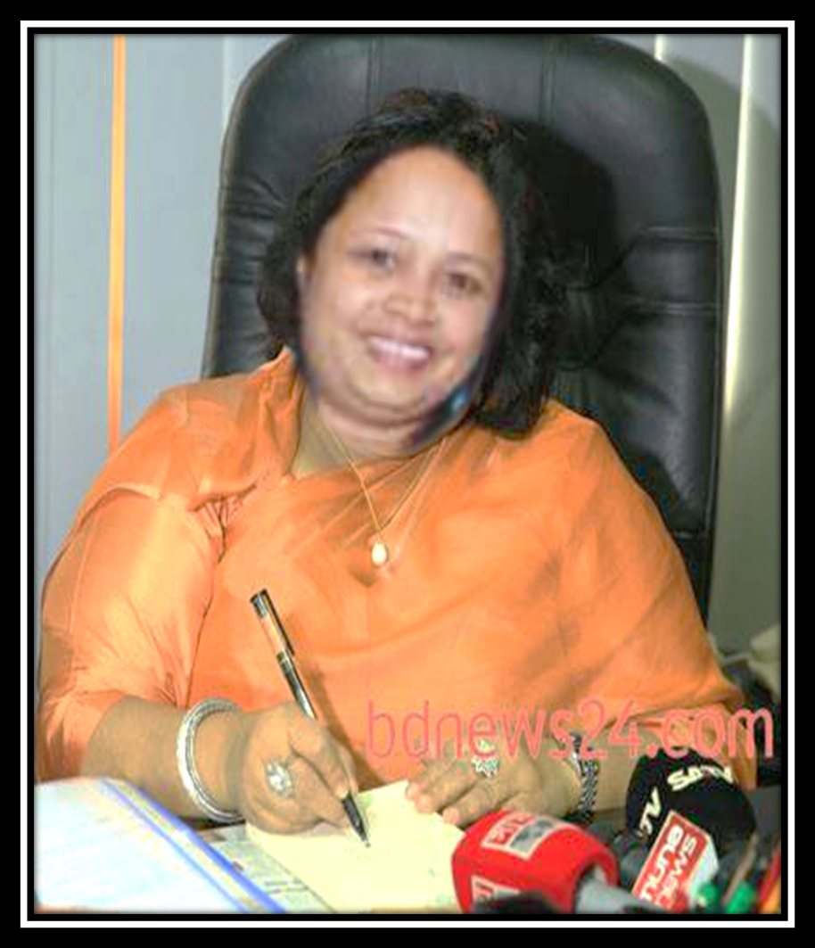
At present , she is the general secretary
of WBF, Sylhet.
Notes:
Teacher may conduct with proper sound, stress and intonation.

Slide 26
In the last 15 years, Rona received much appreciation and a number of awards. Along with other awards, she received Jatiya Juba Padak in 2012. (adapted from The Daily Star).
Notes:
Teacher may conduct with proper sound, stress and intonation.

Slide 27
Questions
1 Do you think the story is news? Why?
2 Where is Rona from? How can you be sure of that?
3 Which fact in the story can be a clue that Rona was educated?
4 What will you mention as the main factor behind Rona’s success?
5 Why could she not expand business earlier?
6 What has Rona started with partners?
7 What has happened to the atmosphere at home?
Notes:
This option may be conducted orally or written.

Slide 28
C Listen to the teacher/CD carefully and tick the best answer.
U8, L3 C Listening text: 8
1 Rona received the DivisionalYouth Award of Sylhet in 2005/2008/2009.
2 Her stall ‘Utsab’ got the second award/medal/prize at the Meena Mela in Sylhet, organized by Dhaka Ladies Club in 2006.
3 The Meena Mela in Sylhet was sponsored/arranged/ organized by Dhaka Ladies Club.
4 In 2010 and 2011, Rona trained a group of poor widows/women/workers in a training programme in Sylhet.
5 Jatiya Juba Padak was awarded in a fashion show/function/workshop in Dhaka.
Notes:
This option may be conducted orally or written.

Slide 29
D Pair work. Discuss with your partner and give a suitable headline to Rona’s story in section B.
E Imagine you are a reporter. Interview Ms Rona. Ask her to talk about her struggle and success. Write down and act out the dialogue in pairs.
F Do you know of any man/woman in your locality who got to a high position from a low position through struggle? Write about his/her story.
Notes:
Section D may be conducted in the class. Section E & F may be the home work for next class.

Slide 30
May Allah bless you all.

Slide 31
Acknowledgement
We would like to express our cordial gratitude to the Ministry of Education, Directorate of Secondary & Higher Education, NCTB, A2i and the panel of honorable editors ( Md. Jahangir Hasan, Assistant Professor (English) TTC, Rangpur, Ranjit Poddar, Associate Professor (English) TTC, Dhaka, and Urmila Khaled, Assistant Professor (English) TTC, Dhaka, to enrich the contents.

